Slide 1

Department of Information Technology
Group Members:
Aisha Imtiaz [ BSIT-19B]
Hajra Khan Lodhi [ BSIT-19A]
Zarnub Khan Lodhi [ BSIT-19A]
Project Title:
BLOOD DONATION SYSTEM (BLOOD UNITY)

Slide 2
Department of Information Technology
Introduction:
Blood donation is a crucial aspect of the healthcare system, as it helps save lives. However, there is still a significant shortage of blood in many areas, which puts lives at risk. To address this issue, a mobile application can be developed that gathers volunteers on one platform and alerts the donor if there’s seeker in need of blood.

Slide 3
Department of Information Technology
Goals:
•Develop a user-friendly mobile application that enables donors to register their blood type, location, and availability to donate blood.
•Provide volunteers with a platform for donating blood
•Alert registered donors who are located within a certain distance from a hospital whenever blood is required.
•Raise awareness about the importance of blood donation through targeted messaging to people who have not yet installed the application.
•Facilitate the organization of blood donation campaigns and encourage users to participate in them.
•Create a system for tracking blood donation history to encourage repeat donations.
•Improve access to blood for patients in need and reduce the risk of blood shortages.
•Increase the number of people who donate blood regularly.
•Promote a culture of blood donation and save lives through this life-saving act.

Slide 4
Objectives:
Develop a user-friendly mobile application that enables donors to easily register their blood type, location, and availability to donate blood.
Test and optimize the application for different devices and screen sizes to ensure a seamless user experience.
Gather customer feedback and incorporate it into the system to continuously improve the user experience.

Slide 5
Department of Information Technology
Tools and Languages:
•Mobile App Development Frameworks: React Native: React Native is great for Cross platform development. It provides a slick, smooth and responsive user interface, while significantly reducing load time
•Database Management Systems: Firebase Real-time database will be used to store and manage user data. This database is using a JSON object No-SQL which will be used to store and sync data in real time.
•Cloud Computing Services: Firebase is a mobile development platform that provides a wide range of cloud computing services.
•Push Notification Services: Firebase Cloud Messaging (FCM) can be used for sending real-time updates to users about their alerts messages.

Slide 6
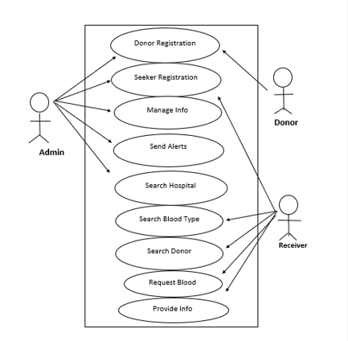
UML Diagrams: Use case:

Slide 7
Department of Information Technology
Modules:
User Interface:
This component will be responsible for providing a user-friendly interface for the customers to interact with the application. It includes the mobile application interface for donors to register, search for nearby blood donation centers and receive alerts.
Donor Management System:
This component manages the donor database and includes features such as donor registration and donor profiles that store information such as blood type, location, and availability to donate blood.
Analytics and Reporting System:
This component provides data analytics and reporting functionality to monitor blood inventory levels, donor registration and donor satisfaction. It includes features such as dashboard and reporting tools.
Notification Module:
This module sends notifications to registered donors and volunteers when their blood type or availability is required by hospitals or blood banks. The system can also send reminders to donors and volunteers.

Slide 8
Conclusion/Summary:
The aim of this project is to develop a mobile application that gathers volunteers who want to donate blood on one platform and alerts them whenever a hospital near them needs blood. The application will also have a feature that sends messages to people who do not know about the application to encourage them to install it and donate blood.
The application will have a user-friendly interface that will enable users to register as donors and specify their blood type and location. Hospitals, blood banks, and the people in need will also be able to register on the application and update their blood inventory levels in real-time. Whenever a hospital, blood bank and the people in need requires blood, They login in this app as a needy person and fill the form then the application will send an alert to all registered donors with the required blood type who are located within a certain distance from the hospital. Donors can choose to accept or decline the request based on their availability and willingness to donate.

